Slide 1
A Simple Java class
// author: Ahmed Ali
package racing;
public class Car{
String color;
private int speed;
private int numOfDoors=4;
public void incrementSpeed(int value){
…………………..
}
public void decrementSpeed(int value){
…………..
}
public int getSpeed(){
…………………..
}
public boolean isMoving()
{
…………………..
}
public static void getNumberOfCars()
{…………………
}
}

Slide 2
Object- Oriented Programming (CS201)
Lecture 3:Using Java API

Slide 3
Class Libraries
A class library is a collection of classes that we can use when developing programs
The Java standard class library is part of any Java development environment
The Java class library is sometimes referred to as the Java API
API stands for Application Programming Interface

Slide 4
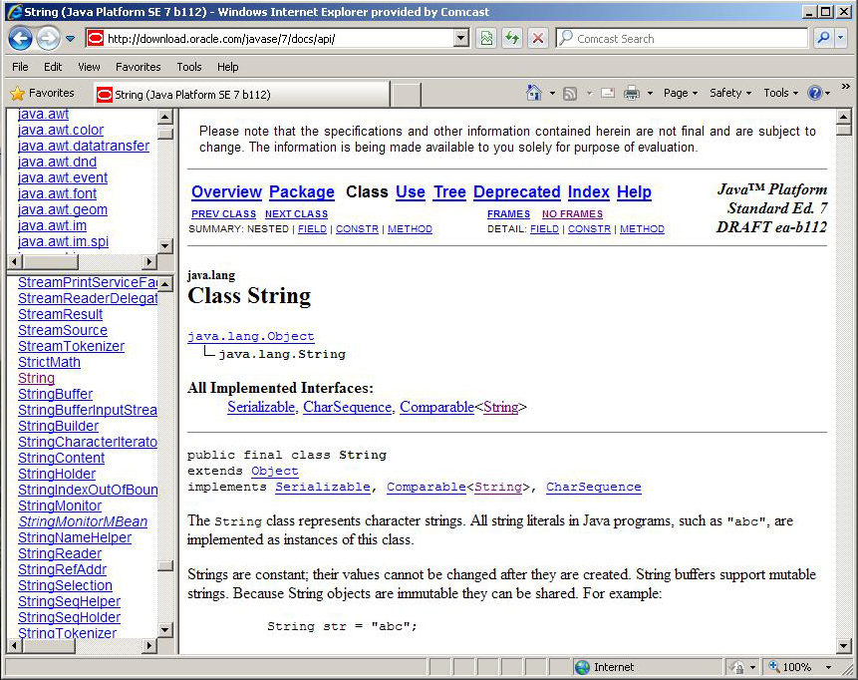
The Java API
Get comfortable navigating the online Java API documentation

Slide 5
Package
A package is a collection of related classes.
If the class belongs to a certain package , The file should be in a folder with the same name as package.
a class can only be in one package
Placing the package declaration at the top of your source file includes these classes in a package with the name that you specify.
ex: package graphics;
If no package is explicitly declared, Java places your classes into a default package containing all files in the same folder.
package racing;
class Car
{
}
package graphics;
class Button
{
}
The Java platform provides an enormous class library ,organized as packages.
This library is known as the "Application Programming Interface“(API).
JAVA API Documentation
Notes:
Package == nameSpace
( need check) in c# you have to import package system

Slide 6
Java API packages (a subset).
JAVA API Documentation

Slide 7
Java classes
public class A
{
public static int x;
public int y;
public A()
{
…………..
}
public A(int z)
{
…………..
}
public static void m1()
{
……………..
}
public void m2()
{
……………..
}
}
Classes in your program might be your own classes or classes that already exist in java API.
A Java class has static and non static variables
Java class has static and non static methods(instance embers)
Java class has one or more Constructors
Constructors are special type of methods , the must have the same name as class , and with no return type.
We use constructor to create objects from classes
Variables, methods and constructors are known as class members
class className
{
}
Variables describing state
Constructors
Methods describing behavior

Slide 8

How to use the class Members
Static members are accessed by the name of class
ex : A.x; A.m1();
To use non static members you have to create objects from the class using constructor
ex: A a1 =new A();
and then access non static members with the object you created
ex : a1.y ; a1.m2();
public class A{
public static int x=10;
public int y=20;
public A()
{
System.out.println("Creating Object");
}
public A(int z)
{
System.out.println("Creating Object with z="+z);
}
public static void m1()
{
System.out.println("Hi from m1");
}
public void m2()
{
System.out.println("Hi from m2");
}
}
public class Test{
public static void main (String [] arg){
//access static members
A.m1();
int i=A.x;
System.out.println("x="+i);
//access instance members
A a1=new A();
a1.m2();
int j=a1.y;
System.out.println("y="+j);
}
}

Slide 9
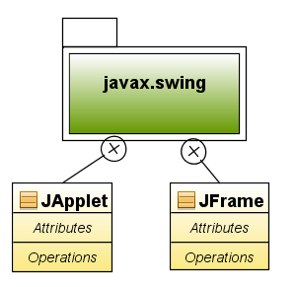
import statements
A Class full name is its package name.class name
import statements specify the packages of the classes used in your Java programs
Without import
......................
javax.swing.JApplet x=………………………………..
With import
import javax.swing.JApplet;
......................
JApplet x=…………………………….
you can have any number of import statements
You can import all classes in a package using * ex : import java.util.*;
java.lang package is imported by the compiler into all programs.
package GUI;
import java.awt.Event;
import java.util.*;
class A
{
….
}
A Java source file has the following elements in this specific order.
An optional package statement
Zero or more import statements,
Any number of class and interface definitions may follow

Slide 10
Using classes from Java API
Package :java.lang
Class Math
Package :java.lang
Class Integer
Package :javax.swing
Class JOptionPane
Package :java.util
Class Random

Slide 11
class java.lang.Math
Method Summary
public static double abs(double a)
public static int round(float a)
public static double ceil(double a)
public static double cos(double a)
public static double floor(double a)
public static double max(double a, double b)
public static double min(double a, double b)
public static double pow(double a, double b)
public static double random()
public static double sin(double a)
public static double sqrt(double a)
import java.lang.Math;
public class Test
{
public static void main (String [] arg)
{
int a=Math.abs(-4);
System.out.println("a="+a);
int b=Math.round(4.6f);
int c=Math.max(4,7);
double d=Math.random();
}
}

Slide 12
class javax.swing.JOptionPane
Method Summary
public static void showMessageDialog(Component parentComponent, Object message)
public static String showInputDialog(Component parentComponent, Object message)

Slide 13
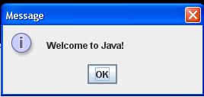
Example 1:Displaying Text in a Message Dialog Box
Package :javax.swing
Class JOptionPane
public static void showMessageDialog(Component parentComponent, Object message) Brings up an information-message dialog titled "Message".
Ex: JOptionPane.showMessageDialog(null, "Welcome to Java!“);

Slide 14
Welcome.java
import javax.swing.JOptionPane;
public class Welcome {
public static void main(String[] args) {
JOptionPane.showMessageDialog(null, "Welcome to Java!“);
}
}
Notes:
The program in Listing 1.1 displays the text on the console, as shown in Figure 1.13. You can rewrite the
program to display the text in a message dialog box. To do so, you need to use the showMessageDialog
method in the JOptionPane class. JOptionPane is one of the many predefined classes in the Java system that
you can reuse rather than "reinventing the wheel." You can use the showMessageDialog method to display
any text in a message dialog box, as shown in Figure 1.14. The new program is given in

Slide 15
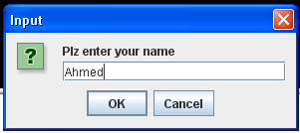
Example 2 : Getting Input from Input Dialogs
Package :javax.swing
Class JOptionPane
public static void showMessageDialog(Component parentComponent, Object message) Brings up an information-message dialog titled "Message".
public static String showInputDialog(Component parentComponent, Object message) Shows a question-message dialog requesting input from the user.

Slide 16
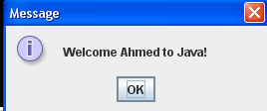
import javax.swing.JOptionPane;
public class WelcomeInMessageDialogBox {
public static void main(String[] args) {
String name=JOptionPane.showInputDialog(null, "Plz enter your name “);
JOptionPane.showMessageDialog(null, "Welcome "+ name +" to Java!“);
}
}
WelcomeInMessageDialogBox.java
Run

Slide 17
Example 3: Converting Strings to Numbers
To convert a string into an int value, use the parseInt method in the Integer class, as follows:
Package :java.lang
Class Integer
static int parseInt(String s) Parses the string argument as a signed decimal integer.
int intValue = Integer.parseInt(intString);
///////////
String s1=“14”;
int i=Integer.parseInt(s1);

Slide 18
import javax.swing.JOptionPane;
public class Adder {
public static void main(String[] args) {
String num1=JOptionPane.showInputDialog(null, "Please enter first number");
String num2=JOptionPane.showInputDialog(null, "Please enter second number");
int x=Integer.parseInt(num1);
int y=Integer.parseInt(num2);
int z=x+y;
JOptionPane.showMessageDialog(null, "the sum is "+ z);
}
}

Slide 19

class java.util.Random
import java.util.Random;
public class Test
{
public static void main (String [] arg)
{
Random rnd=new Random();
int x=0;
for(int i=0; i<10;i++)
{
x=rnd.nextInt(11);
System.out.println("x="+x);
}
}
}
Constructor
Random( )
Methods
public int nextInt(int n)
Returns a pseudorandom, uniformly distributed int value between 0 (inclusive) and the specified value (exclusive)

Slide 20
Creating a random guess Game
import java.util.Random;
import javax.swing.JOptionPane;
class GuessingGame{
public static void main (String [] arg){
int numofTrials=5;
Random rnd=new Random();
int secretNum=rnd.nextInt(11);
JOptionPane.showMessageDialog(null,"Choose a number between 0 and 10 \n you have only 5 trials");
boolean sucess=false;
String guessString="";
int guess=0;
for (int i=0;i<numofTrials;i++){
guessString=JOptionPane.showInputDialog(null,"What is your guess");
guess=Integer.parseInt(guessString);

Slide 21
if (guess==secretNum)
{
JOptionPane.showMessageDialog(null,"Congratulations ");
sucess=true;
break;
}
if (guess>secretNum)
{
JOptionPane.showMessageDialog(null,"Too Big ");
}
if (guess<secretNum)
{
JOptionPane.showMessageDialog(null,"Too small ");
}
}// end loop
if(!(sucess))
JOptionPane.showMessageDialog(null,"You Lost ");
}//end of main method
}//end of class

Slide 22
Example :Reading from Console
Java.util.Scanner
public Scanner(InputStream source)Constructs a new Scanner that produces values scanned from the specified input stream. Hint: System.in represents the Console
public int nextInt() Scans the next token of the input as an int.
public double nextDouble() Scans the next token of the input as a double.

Slide 23
import java.util.Scanner;
class ScannerDemo
{
public static void main (String [] arg)
{
Scanner scan=new Scanner(System.in);
System.out.println("Please Enter first number");
int num1=scan.nextInt();
System.out.println("Please Enter Second number");
int num2=scan.nextInt();
int sum=num1+num2;
System.out.println("The sum of " + num1 +" and "+num2+"="+sum);
}
}

Slide 24
3 Type of Errors might be in your program
i-Compile Errors
Compile errors occurs on attempting to compile your file
Compile errors prevent the creation of the .class file
Compile error occurs when a syntax rule is not obeyed
ii-Runtime Errors
Runtime errors occurs after the program has compiled successfully and is running
Runtime error in java are called Exceptions
Exceptions can occur for many reasons including a wrong input from user or a certain resource (eg. A file) that was not found.
iii-Logic Error
The class compiled and run without reporting any errors
The task is not executed correctly due to algorithmic error

